Slide 1
Number Theory & Algebra
20MAT112
Seminar Project

Slide 2
TEAM MEMBERS
Aishwarya G | CB.EN.U4CYS21003
Aishwarya G S | CB.EN.U4CYS21004
Alagu Soundarya G | CB.EN.U4CYS21005
Anuvarshini M K | CB.EN.U4CYS21008
Suvetha D P | CB.EN.U4CYS21078
Swetha V | CB.EN.U4CYS21079
Mittul R | CB.EN.U4CYS21042
Mohamed Jasir Faiez M M | CB.EN.U4CYS21043
Monish T | CB.EN.U4CYS21045
Yuvaraj Kumar G P | CB.EN.U4CYS21090

Slide 3

Topic – 6
Pollard’s P-1 Factorization Algorithm
Introduction to Pollard’s Factorization
Algorithm for Pollard’s P-1 Factorization
Problems
Limitations of using Pollard’s P-1 Factorization
Counter Examples

Slide 4
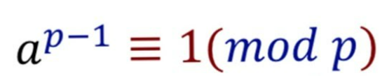

Introduction to
Pollard’s P-1 Factorization Algorithm
Product of two primes
where p,q - prime numbers
The application of using pollard (p-1) factorization is of factorizing N
$$n=pq$$
Pollard’s (p-1) method is also called as Monte Caelo Method
To perform Pollard p-1 factorization we require some knowledge from Fermat’s Theorem !
Fermat’s Theorem (a,p) = 1
where a – is an integer
p - prime
Integer a should be coprime to p

Slide 5
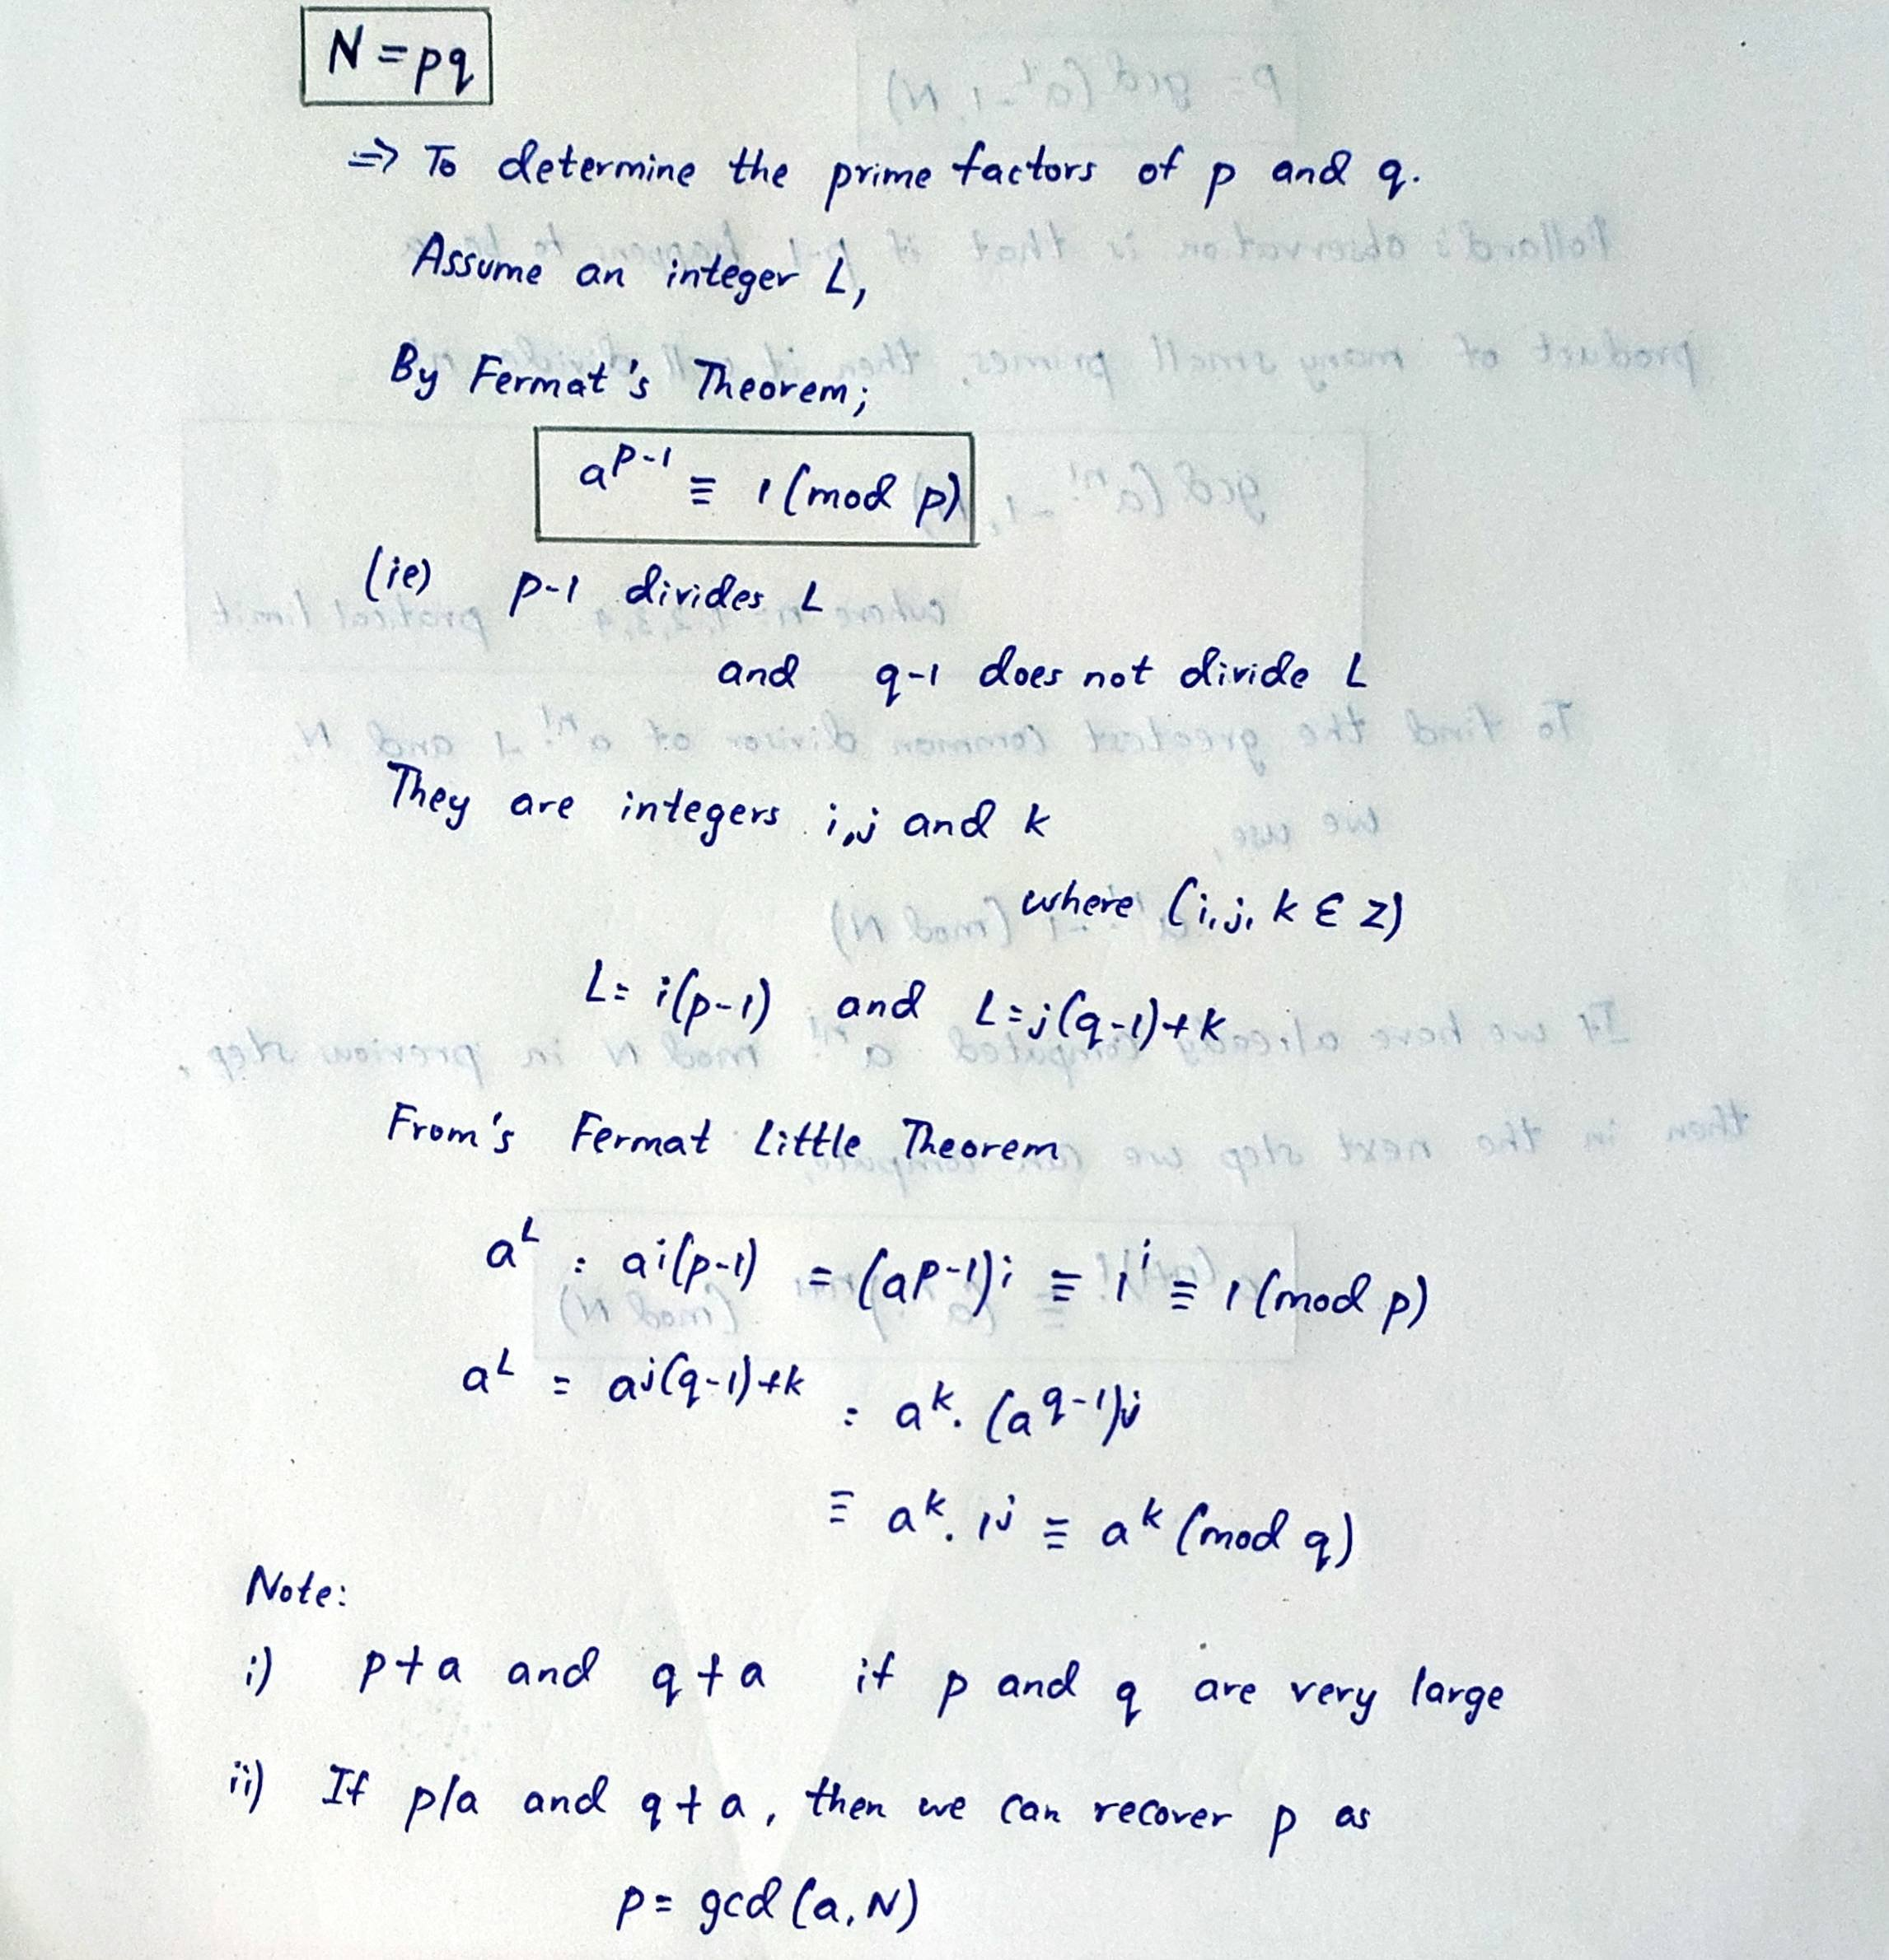

Slide 6
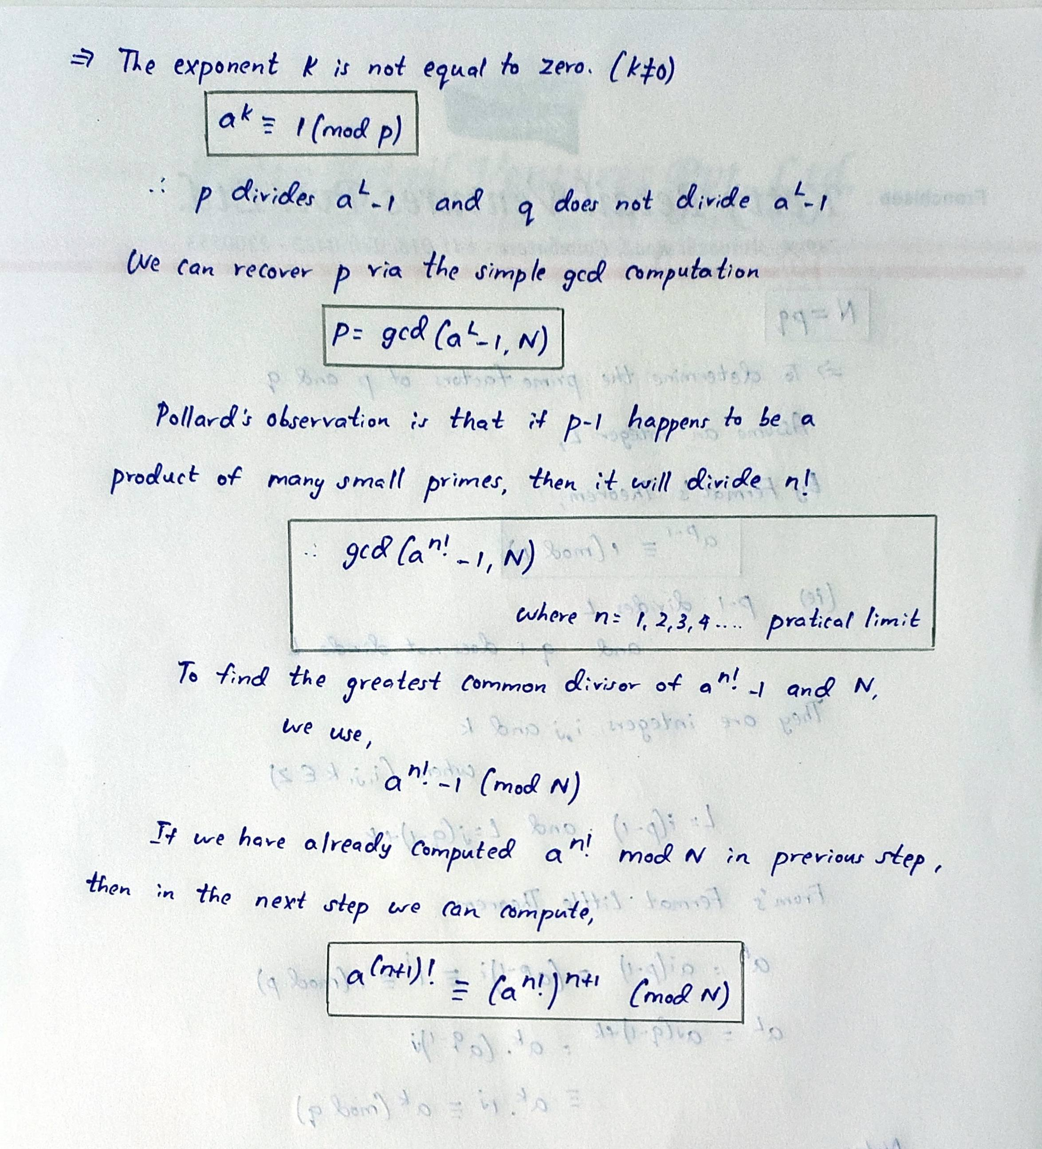

Slide 7
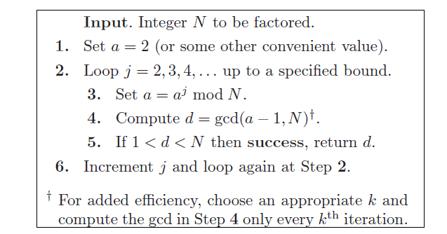
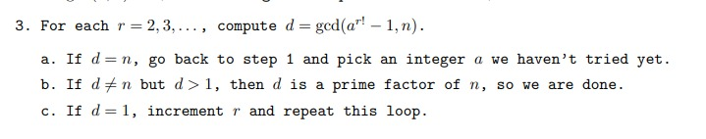
Factorization Algorithm

Slide 8
Program Code
# importing "math" for
# calculating GCD
import math
# importing "sympy" for
# checking prime
import sympy
# function to generate
# prime factors
def pollard(n):
# defining base
a = 2
# defining exponent
i = 2
# iterate till a prime factor is obtained
while(True):
# recomputing a as required
a = (a**i) % n
# finding gcd of a-1 and n
# using math function
d = math.gcd((a-1), n)
# check if factor obtained
if (d > 1):
#return the factor
return d
break
# else increase exponent by one
# for next round
i += 1

Slide 9
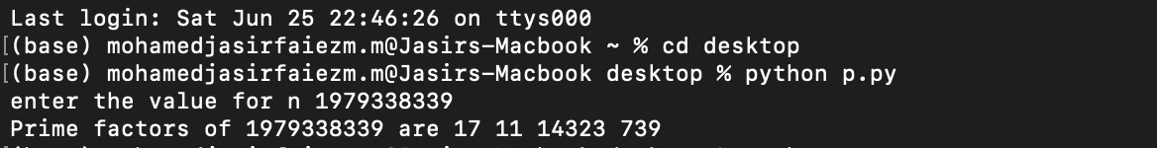
# Driver code
n = int(input(“Enter a Number : “))
# temporarily storing n
num = n
# list for storing prime factors
ans = []
# iterated till all prime factors
# are obtained
while(True):
# function call
d = pollard(num)
# add obtained factor to list
ans.append(d)
# reduce n
r = int(num/d)
# check for prime using sympy
if(sympy.isprime(r)):
# both prime factors obtained
ans.append(r)
break
# reduced n is not prime, so repeat
else:
num = r
# print the result
print("Prime factors of", n, "are", *ans)

Slide 10
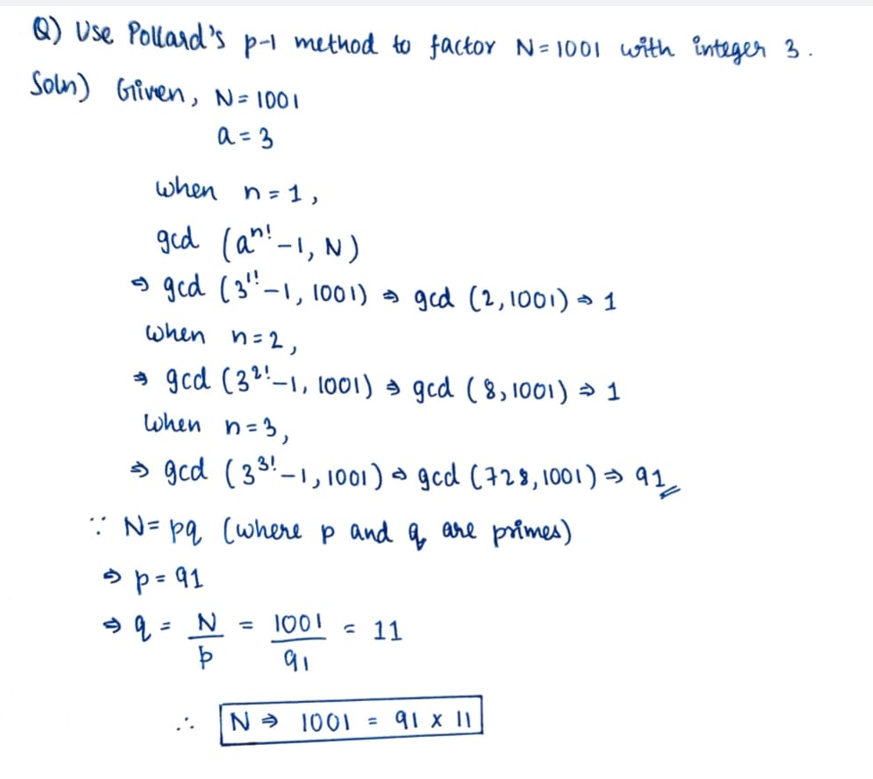

Example Problems
In Pollard’s P – 1 factorization method we can use almost any integer a in
$${GCD(a}^{n!}−1,N)$$
The Advantage in initializing the
algorithm with small integers such as a=2
is because , it is less complex to compute the powers of 2

Slide 11
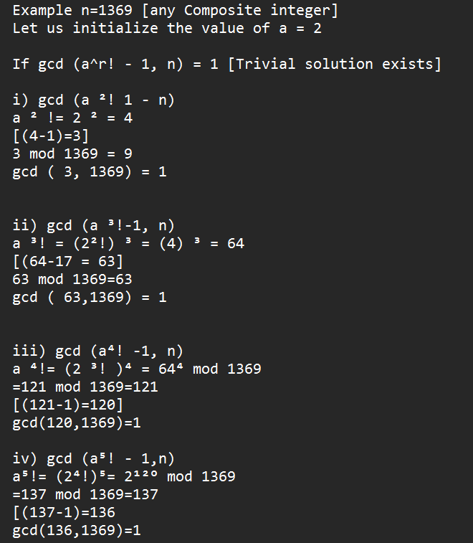
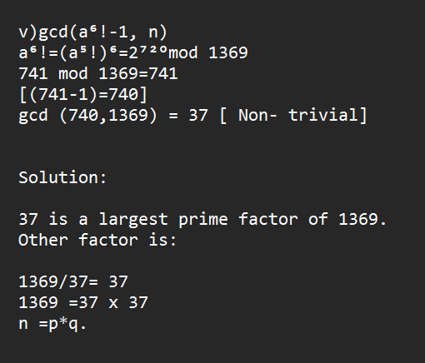
Example Problems

Slide 12

Limitations of using Pollard’s P-1 Factorization
Pollard’s P-1 Factorization method is not useful for all numbers, there are certain types of numbers for which it is quite efficient
Pollard’s observation is , if p − 1 is a product of many small primes, then it will divide N
Pollard’s P-1 Factorization method is not applicable / not efficient for product of large prime numbers!
Even for a = 2 and quite moderate values of n (ie) n = 100, it is not feasible to compute exactly.
The number has more than 10157 digits, which is larger than the number of elementary particles in the known universe!
$$2^{100!}$$

Slide 13


Pollard’s P-1 Factorization Method is not applicable when
$${GCD(a}^{n!}−1,N)=N$$
In that case ;
$a^{n!}$ =1(mod N)

Slide 14
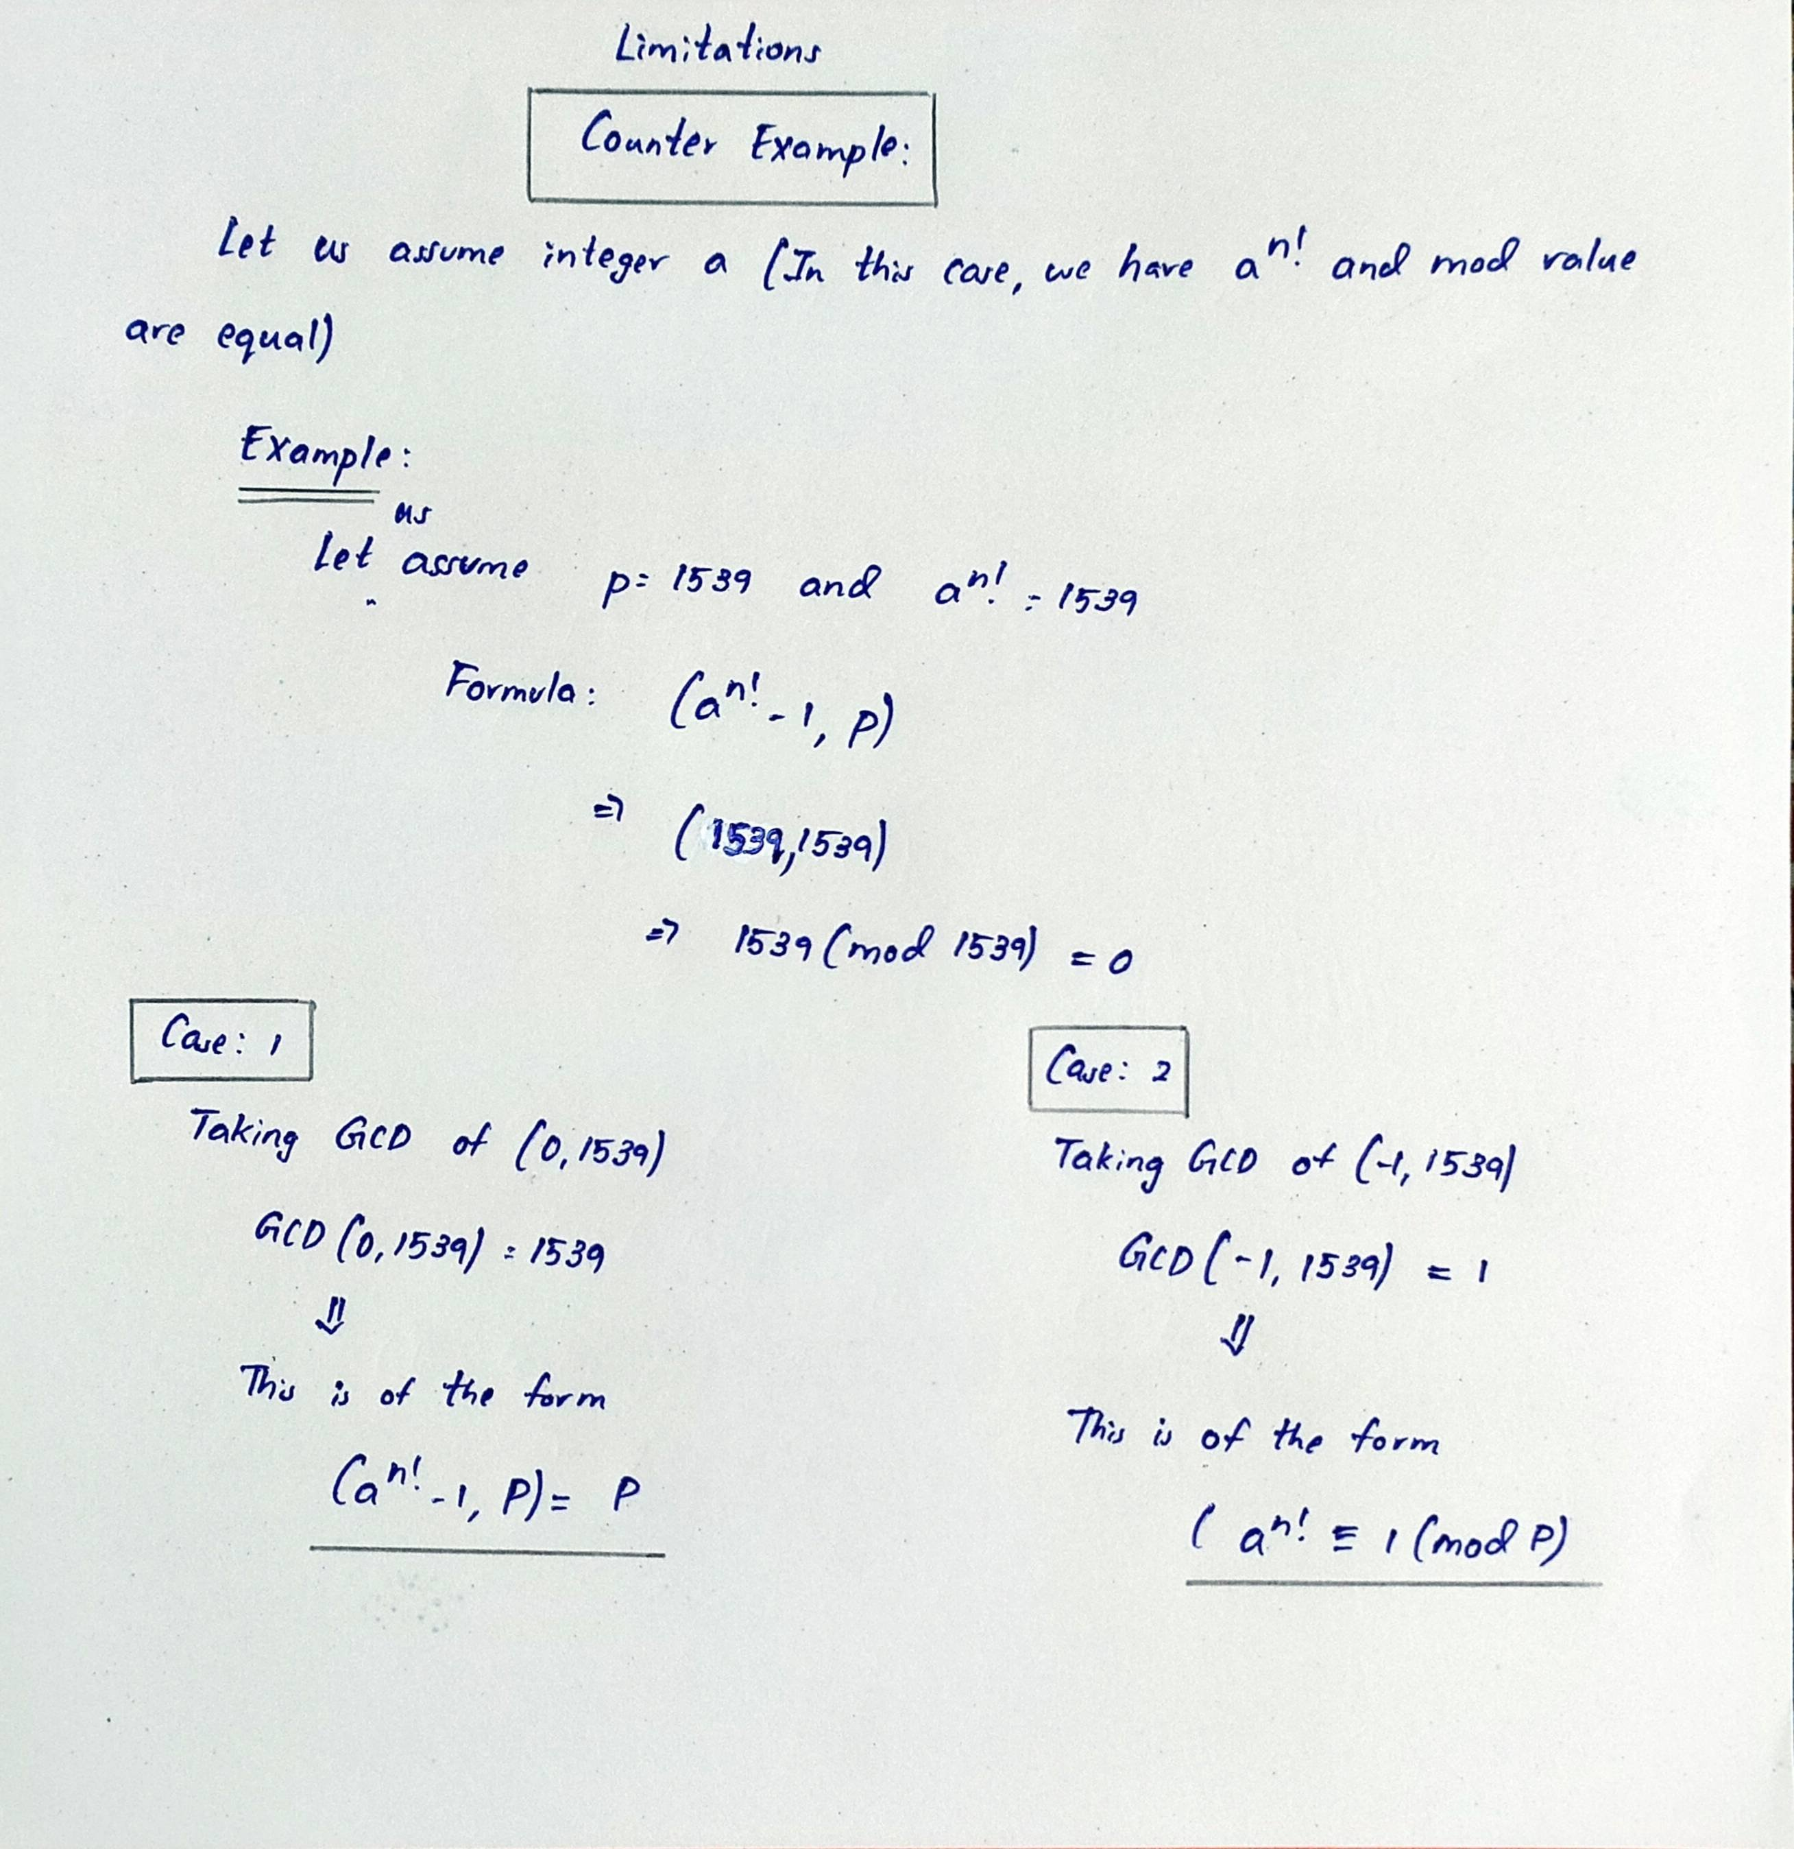
Counter Example

Slide 15
Reference Link
https://youtu.be/bI_Opi4KdXo
https://youtu.be/zYIxFjvT0h0
https://youtu.be/2n8cQcFsanQ
Notes : http://robin.pollak.io/wizard_factoring.pdf
Book : An Introduction to Mathematical Cryptography by Jeffery Hoffstein Pg No : 133 to 136

